Slide 1
Leadership Development
Ronald Bailey
VP of Industry Development

Slide 2
Leadership Development
Welcome
Objectives
IBEW/NECA Letter
Leadership Foundation
Talent Management
Cultural Diversity
Wrap Up
Q&A
Agenda

Slide 3
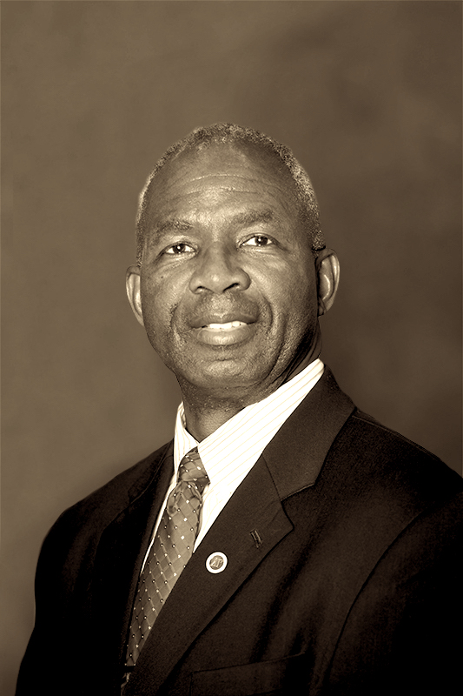
Leadership Development
The Six Rights
Be the right person
With the right person
At the right places
At the right times
Making right decisions
And doing the right thing
Ronald Bailey
PRINCIPLES OF LEADERSHIP

Slide 4
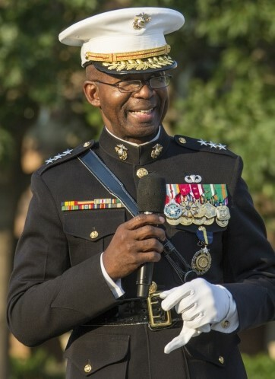
Leadership Development
Bailey’s Laws
Leadership
Attitude
Warfighting

Slide 5
Leadership Development
To provide a clear understanding of the diversity program.
To raise a greater awareness and sensitivity to cultural diversity.
To discuss benefits of workplace diversity.
Objectives

Slide 6
Leadership Development
A new focus
A new strategic plan
A new vision for the 21st century
New Way of Thinking

Slide 8
Leadership Development
Jef
Fagan
James
Farrell
Wanessa
Alves
Melissa
West
Pete
Mastrorocco
Marco
Giamberardino
Ian
Andrews
DE&I National Staff
Tom
McClean
Ron
Bailey
Jessica
Pray

Slide 9
Leadership Development
Edwin
Lopez
Kristin Causby
Debra Margraf
Kendra Dinkins
Kevin
Moran
Joseph Kaluhiokalani
Paige Richards
Maurice Rahming
DE&I Task Force
Stephen Harvey
Juanita Mitchell
Sam
Lacher
Joshua Wheeler

Slide 10
Leadership Development
5
Year
Action
Plan
Campaign
Plan
Strategic
Plan
1 – 2
Years
Monthly & Daily Task
WAY AHEAD

Slide 11
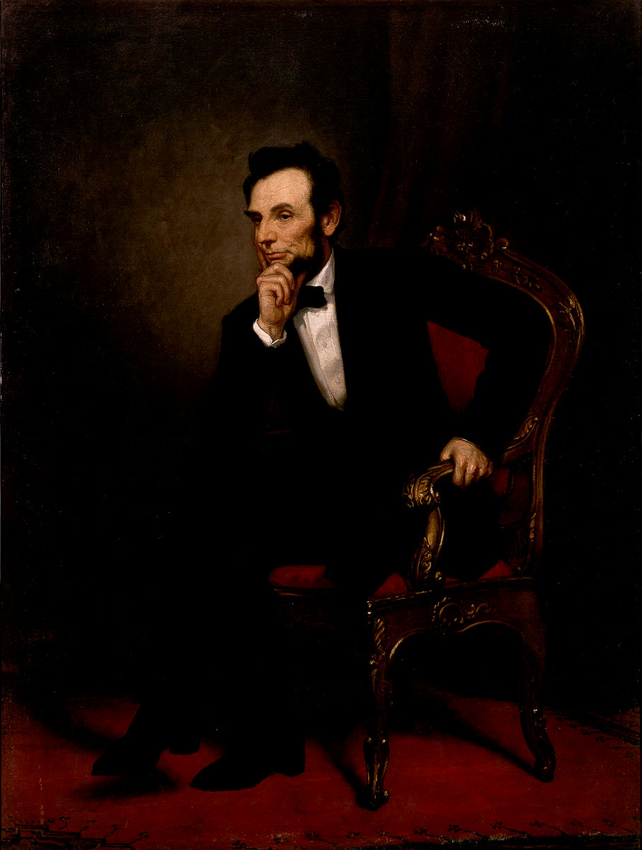
Leadership is the art of influencing and directing others in such a way as to obtain their willing obedience, confidence, respect, and cooperation to accomplish the mission.
Abraham Lincoln
LEADERSHIP DEFINED

Slide 12
Customer Focused: Our customers are our members
Leadership: To be the driving force to shape our industry
Partnership: Chapters will collaborate to deliver optimal value for members
Accountability: We measure what we do with a commitment to continuous improvement, transparency, and integrity
Core Values
Leadership Development

Slide 13
Excellence: The standard by which individual and team performance is measured and rewarded
Innovative: A declaration to be more effective through delivering creative solutions
Stewardship: Invest in our people and industry to leave our world a safer and better place for future generations
Community: To share experiences, ideas and have fun
Core Values
Leadership Development

Slide 14
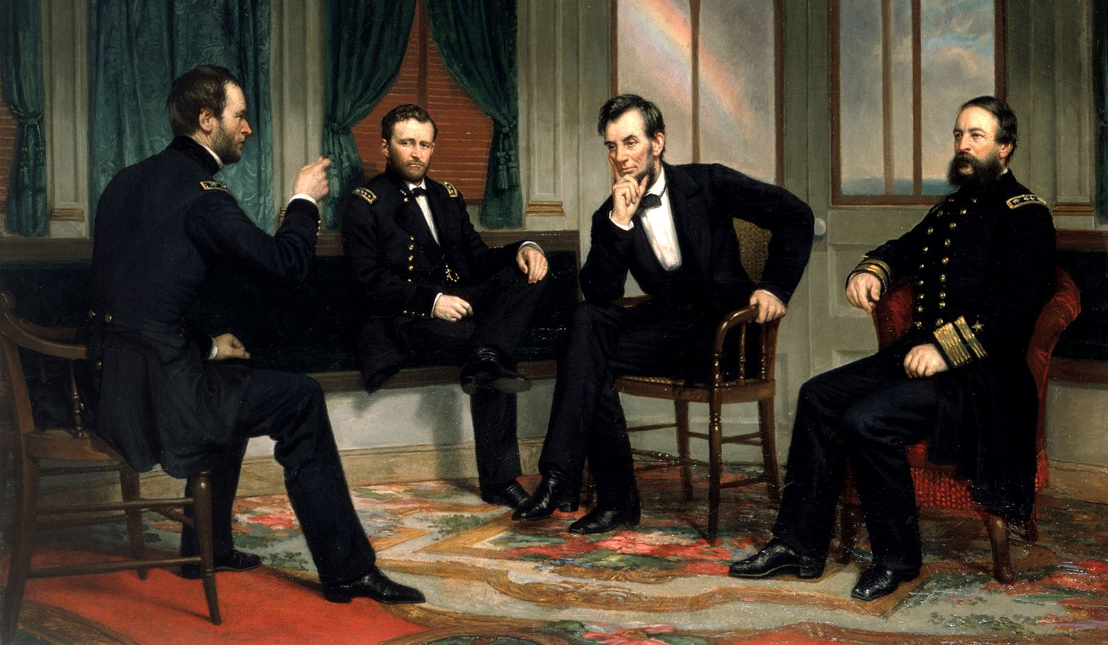
LEADERSHIP
CONTRACTORS

Slide 15
Talent Management
Diversity is the mosaic of people who bring a variety of backgrounds, styles, perspectives, values and beliefs as assets to the groups and organizations with which they interact.
Defining Diversity

Slide 16
Leadership Development
Culture refers to the cumulative deposit of knowledge, experience, beliefs, values, attitudes and religion by a group of people generally without thinking about them.
Defining Culture

Slide 17
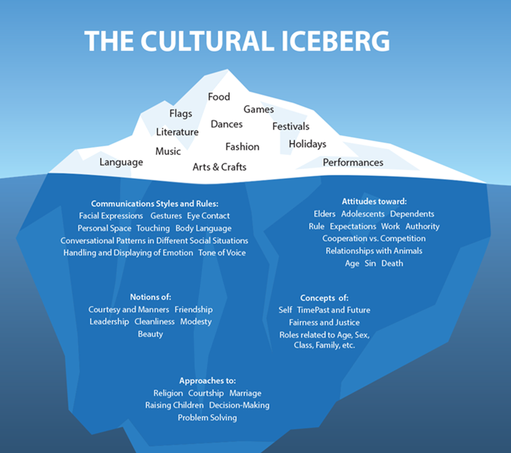
Leadership Development
Surface Culture
Shallow Culture
Deep Culture

Slide 18
CULTURAL DIVERSITY
Geographic
Location
Military Experience
Socioeconomic
status
Work Experience
Disability
Age
Ethnic Heritage
Work/thinking
Style
Education
Primary and Secondary Dimensions of Diversity
Sexual
Orientation
Family Status
Gender
Religion
Race
Communication Style
First Language
Organizational Role and Level

Slide 19
CULTURAL DIVERSITY
The ability to effectively communicate with others is one of the most powerful tools for personal and/or professional success.
Emotion, communication and conflict are present in all human interactions and affects each of us in different ways.
Everyone manages emotion, communication and conflict from habit – patterns and styles developed early in life and over time.
Communication

Slide 20
CULTURAL DIVERSITY
Past Experiences Shape Communication Style
Communication doesn’t just happen; your style is based on your experiences that over time have developed into a pattern of attitudes and actions.
It is a continuous cycle. Your experiences influence your thoughts. Your thoughts, over time, become your attitudes. These attitudes become the blueprint for new experiences, which develop into patterns of behavior.
An awareness of your personal style is critical to begin to transform negative attitudes and behaviors into positive ones.
Communications

Slide 21
CULTURAL DIVERSITY
Sometimes people have a barrier that impedes their listening skills. Awareness of a barrier is the first step in being able to overcome it.
Barriers to listening include:
past experiences that influence our reaction to the speaker or the message
worry, fear, anger, grief and depression
individual bias and prejudice
semantics and language differences
noise and verbal "clutter"
preoccupation, boredom and shrinking attention spans
Barriers to Listening

Slide 22
CULTURAL DIVERSITY
Cultural Diversity in the Workplace
Cultural diversity in the workplace provides strength. It also challenges individuals to respond to their diverse work environment effectively.
“Valuing” individual and group cultural differences is critical to achieving the organizational goals.
Workplace Cultural Diversity

Slide 23
CULTURAL DIVERSITY
Multicultural Calendars (cultural information divided by the month, holiday and country)
Readings
Lunch & Learns/ Potlucks representing cultures
Fact sheets
Other tools that foster dialogue and questions within the organization
Intentionally invest in multicultural books and materials within your libraries
Supporting Cultural Diversity

Slide 24
CULTURAL DIVERSITY
Improved understanding of those you work for, with, and around.
Creates a work environment that allows everyone to reach their full potential.
Provides multiple perspectives on problem solving.
Better performance outcomes.
Increases employee productivity.
Increased retention rates.
Boosts employee morale.
Improved customer relations.
Reduces complaints and grievances.
It’s the right thing to do!
Benefits of Workforce
Diversity and Inclusion

Slide 25
CULTURAL DIVERSITY
“When we feel a sense of belonging it is not because we are the same as everyone else, but because we have been accepted as we are.”
Perspective

Slide 26
CULTURAL DIVERSITY
Walk the talk. Make your actions consistent with your words.
Demonstrate a vision and values worth following.
Co-workers make mistakes. So do you. Admit and learn from them.
Know your weaknesses so you can build a team to make up for them.
Never publicly blame anyone except yourself.
Stay positive and expect it from your people.
Be open to new ways of doing things. Embrace change- it’s inevitable.
Think before you make a comment.
Embrace and benefit from diversity.
Take your work, but not yourself, seriously.
It’s not about degrees, titles or position . What really counts is what legacy you leave behind for future generations.
Wrap Up

Slide 27
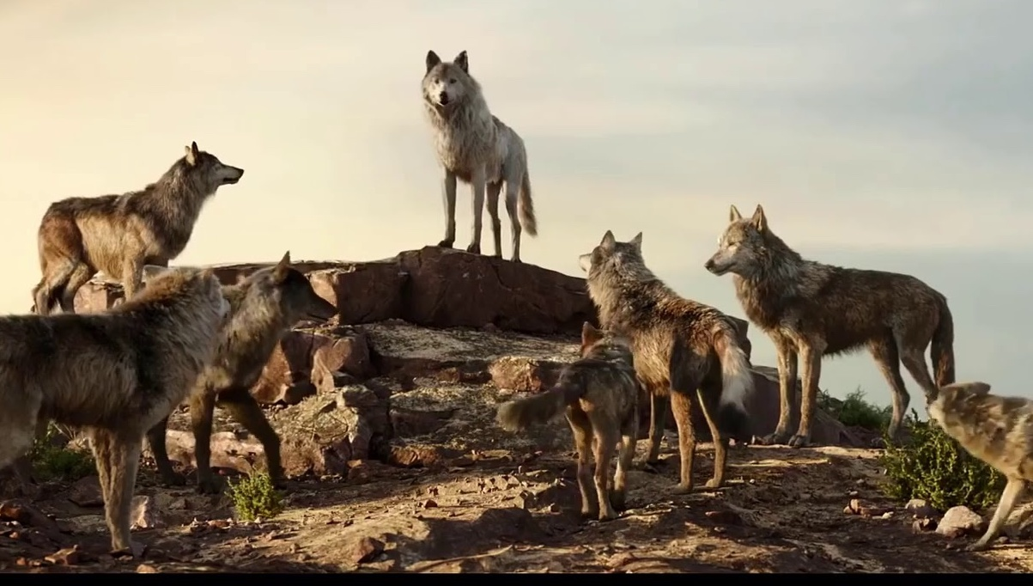
LEADERSHIP: HINDSIGHT 2021
LOOKING BACK
(MENTOR)
LOOKING FORWARD
(MENTEE)

Slide 28
Ronald Bailey, VP of Industry Development
Email: Ronald.Bailey@necanet.org
Telephone: 703 508 7020
Contact Information
CULTURAL DIVERSITY
PRINCIPLES OF LEADERSHIP

