Slide 1
NECA: FROM THE PAST TO LEGACY LEADERSHIP OUR NEXT 25 YEARS OF POSITIVE CHANGE
MARK BRESLIN
WWW.BRESLIN.BIZ

Slide 2
YOUR LEGACY IN THIS INDUSTRY
HOW WOULD YOU DEFINE THE WORD LEGACY?
WHAT DOES IT MEAN TO YOU?

Slide 3
LEGACY LEADERSHIP
2021-2046
A GROWTH MINDSET FOR THE INDUSTRY
NEW PEOPLE ENGAGEMENT SKILL SETS
INDUSTRY CHANGING INITIATIVES

Slide 4
LONGEVITY = CHANGE = SURVIVAL
ANHEUSER-BUSCH 1860 150+ YEARS
JOSE CUERVO 1758 250+ YEARS
BERETTA ARMS 1526 485 YEARS
KONGO GUMI CONSTR. 578 1435 YEAR
NECA 100 YEARS?

Slide 5
FOUNDATION FOR ACTION
POSITIVE CHANGE IS A PRIMARY DRIVER OF SUCCESS, SECURITY AND THE FUTURE. HELPING OTHERS SEE THAT IS YOUR LEGACY.
YOUR OWN LEGACY PERFORMANCE AND EXECUTION ARE THE MOST IMPORTANT FACTORS DIRECTLY WITHIN YOUR CONTROL.

Slide 6
NECA PACE OF CHANGE RESPONSE
IDENTIFYING PACE OF CHANGE
2016 - 2021 (list)
2021 – 2026
CHANGE RATING GRADE 1-10?

Slide 7
NECA LEADERS AND CHANGE
MORE CHANGE,
COMING FASTER,
FOREVER.
WHAT DOES THIS MEAN FOR YOU AS LEADERS?

Slide 8
2021 TO 2046?
THE NECA TIME CAPSULE

Slide 9
CHANGE, CULTURE & SUCCESS
CASE STUDY: FORTUNE’S MOST ADMIRED
TOP FIVE YEAR AFTER YEAR REPEAT WINNERS?
BELIEF = BUY-IN = SUCCESS FOR EVERYONE

Slide 10
THE FIRST LEGACY CHALLENGE
THE CURRENT LEADERSHIP MINDSET
AN UNDERPERFORMING CULTURE
OPERATIONAL, ECONOMIC & PEOPLE IMPACTS

Slide 11
THEN AND NOW A NEW INDUSTRY BELIEF SYSTEM
THEN: “WE BUILD THE WORK”
NOW: “WE BUILD THE PEOPLE WHO BUILD THE WORK”

Slide 12
LEGACY: IT’S ABOUT THE PEOPLE
DEVELOP
MENTOR
EMPOWER
KNOWLEDGE TRANSFER & SUCCESSION
RECRUIT

Slide 13
LEADERSHIP AND MINDSET
WHAT ARE THE BEST & WORST PARTS OF OUR BUSINESS FOR YOU?

Slide 14
BEST AND WORST
BEST
PRIDE IN ACCOMPLISHMENT
TEAM SUCCESS
MENTORING & TEACHING
CHALLENGE
PROBLEM SOLVING
RESPONSIBILITY
GROWTH
OPPORTUNITY
BAD ATTITUDES
LOW GIVE-A-SHIT FACTOR
CONFLICT
RESISTANCE TO CHANGE
OFFICE VS FIELD
BAD OWNERS
POOR SUBS
WORST

Slide 15
25 YEARS AGO & THE FIXED MINDSET
APPRENTICE TREATMENT
THE NEW IDEA AND Y-N-P-T-T
HEAD & HEART BEFORE HANDS
MINDSET VS. MONEY
BUY-IN VS. RULES
BELIEFS VS. PERCIEVED LIMITS

Slide 16
MINDSET: THEN AND NOW

Slide 17
GROWTH VS. FIXED MINDSET
GROWTH
I HAVE LEARNING
POTENTIAL
OTHERS HAVE UNLIMITED
UPSIDE
FIXED
I AM WHAT I AM
OTHERS ARE WHAT THEY ARE
STRIVING TO BE AN 8
FINE TO BE A 5

Slide 18
HOW DO WE CHANGE THIS MINDSET?
TRANSFORMATION: LEADERS CHANGE BELIEF SYSTEMS
CASE STUDY: EVOLUTION OF SAFETY BELIEF SYSTEM

Slide 19
FIVE WAYS TO USE THE SAFETY MODEL FOR ENGAGMENT
MAKING IT IMPORTANT TO LEADERSHIP AND MANAGEMENT
COMMUNICATING FROM TOP TO BOTTOM OF ORGANIZATION
EMPHASIZING KEY THEMES IN MEETINGS AND ONGOING TRAINING
MEASURE AND MONITOR AT BEST PRACTICES LEVEL

Slide 20
ELEVATE YOURSELF
TO
ELEVATE OTHERS
LEADER. CO-WORKER. SPOUSE. PARENT.

Slide 21
THE 2ND LEGACY CHALLENGE
ENGAGEMENT AS THE FOUNDATION OF THE INDUSTRY
PICK ONE:
SKILLED WORKFORCE
ENGAGED WORKFORCE
WHAT % LACK THE RIGHT SKILLS, ATTITUDES OR BEHAVIORS?

Slide 22
A LEADERSHIP BLIND SPOT?
WHEN WAS THE LAST TIME YOU WERE BORED, UNINSPIRED OR DISENGAGED AT WORK?

Slide 23
PROBLEM OR OPPORTUNITY?
LESS THAN 30% OF AMERICANS IN THE WORKPLACE REPORT BEING ENGAGED.
- Gallup Organization Poll

Slide 24
ENGAGEMENT ROI
ENGAGEMENT LARGELY DETERMINES THE LEVEL OF DISCRETIONARY EFFORT THE EMPLOYEE PROVIDES.

Slide 25
COMPANY PERFORMANCE VALUE MATRIX
Workforce
Quality
Productivity
Competitiveness
Value vs. Price
Notes:
Note: This slide replaces “Challenges for Union Construction,” in which all four quadrants (workforce quality, workforce productivity, etc.) were separate bullets, and does a better job of breaking out how superior talent can make union construction more competitive.
This is where we need to focus, and the workforce we have is at the center of it. Making our workforce unbeatably superior is critical if there’s even going to be a future, and that starts with making the best choices in apprentices.
TRANSITION:
And we’re honestly trying to make the best choices, but we have some bad habits that make us our own worst enemies. Let’s call them the five deadly sins.

Slide 26
THE POWER OF ENGAGEMENT
PROFIT: FORTUNE TOP 100 PLACES TO WORK HAVE OUTPERFORMED THE S&P 500 BY A RATIO OF 2:1 FOR 14 YEARS. 12% VS. 6.5%
SUSTAINED SUCCESS: CULTURE IS MORE IMPORTANT THAN LEADERSHIP (Deloitte’s Survey)
TALENT: 100 to 1 RATIO? THE CONTAINER STORE? AND PAYS 2X MORE THAN PEERS?

Slide 27
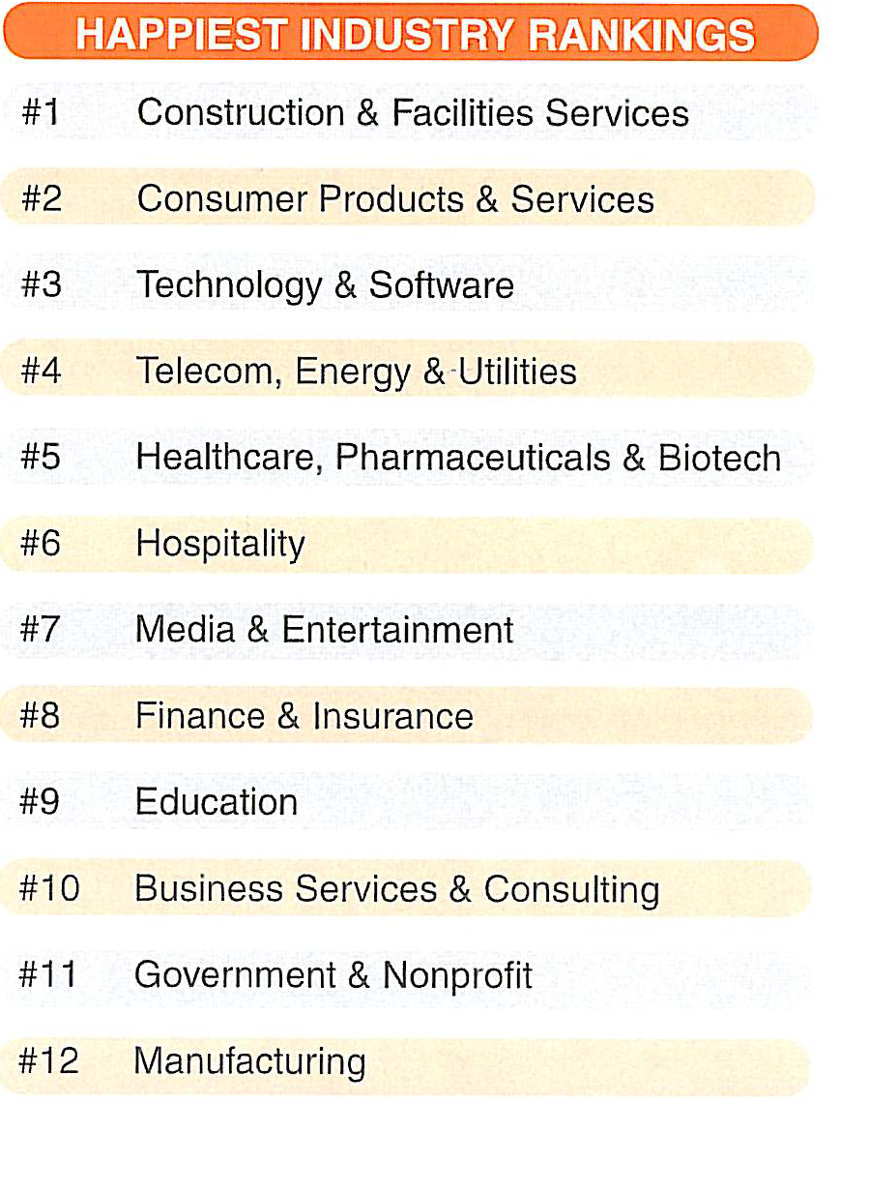

Slide 28
THE SURVEY SAYS

Slide 29
NEXT GEN LEADING THE THIRD INDUSTRY CULTURAL CHANGE
CREATING A NEW BELIEF SYSTEM
THE FIRST TWO CULTURAL CHANGES?
WHY DID THEY OCCUR?
WHAT IS THE THIRD CULTURAL CHANGE?
A PEOPLE DEVELOPMENT & PERFORMANCE CULTURE

Slide 30
ENGAGING CRAFT WORKERS
IT’S NOT “US vs. THEM”
PART OF SOMETHING IS THE THEME
CONTRACTOR IS NOT THE RICH/BAD GUY
TEAM APPROACH IS THE ONLY ONE
WE THRIVE OR SUFFER TOGETHER
WHAT DO THEY NEED TO KNOW??

Slide 31
EXPLAINING THE PARTNERSHIP
CONTRACTOR: Takes risk
UNION: Provides infrastructure
WORKFORCE: Delivers on the project
CONTRACTOR
UNION
RANK & FILE

Slide 32
THE 20-60-20 STRATEGY FOR ENGAGEMENT
TOP PERFORMERS
20%
STANDARD PERFORMERS
60%
FILL IN GUYS
20%

Slide 33
ENGAGEMENT CRITERIA RANKED
RECOGNITION
CAREER OPPORTUNITY AND PATH
CLEAR AND HONEST COMMUNICATION
ABILITY TO DO WHAT THEY DO BEST
PAY
84% OF HOW AN EMPLOYEE FEELS ABOUT THEIR COMPANY RELATES TO THEIR IMMEDIATE SUPERVISOR.

Slide 34
# 1 ENGAGEMENT STRATEGY
RECOGNITION
=
MOTIVATION &
DISCRETIONARY EFFORT

Slide 35
# 2 ENGAGEMENT STRATEGY
MY WORK IS MEANINGFUL AND I MATTER.

Slide 36
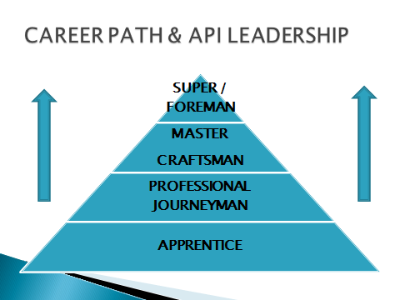
RECRUITMENT NARRATIVE
VISIBLE CAREER PATH PLAN

Slide 37
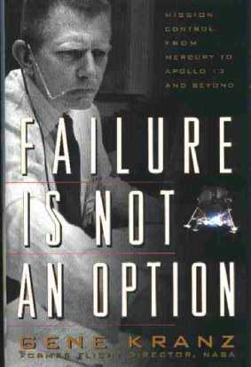
TOOLS: USING EVERYTHING IN THE BOX
TIME AS A DRIVER, NOT A RESTRICTOR
OF OPTIONS

Slide 38
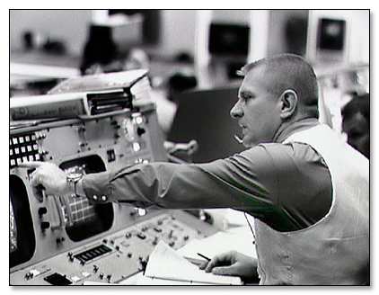
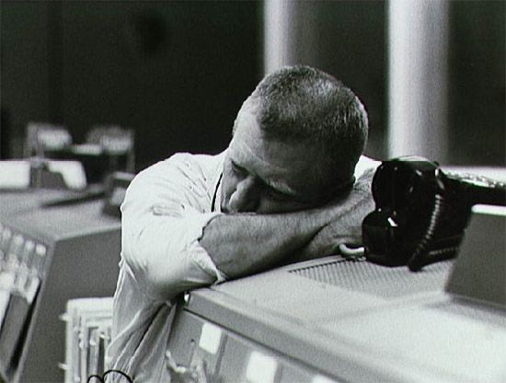
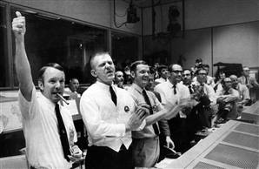
EVERY TOOL USED ENSURES SURVIVAL
NO TIME FOR DELAY.
TRY EVERYTHING. REINVENT NOW.

Slide 39
TOOLS = INDUSTRY CHANGING IDEAS
WHAT ARE THE IDEAS AND ACTIONS WE NEED TO TAKE TO TRANSFORM THE NEXT 25 YEARS OF THIS BUSINESS?

